Slide 1

Housing Hub : A Society
Coordination System

Slide 2

Presented By
Group No. 19
Meet the team transforming ideas into reality.
Shoeb Shaikh (0080)
Anuja Khumkar (0039)
Rohan Goilkar(0072)
Himanshu Singh(0033)
Anjali Udawant (0015)

Slide 3
Introduction
'Housing Hub Society Coordination System', which aims to streamline communication and day-to-day
operations in residential societies.
Our goal was to build a full-stack solution that brings together Admins, Residents, Security Staff, and
Management into one digital platform.
It addresses common issues such as outdated workflows, lack of transparency, and security concerns.

Slide 4
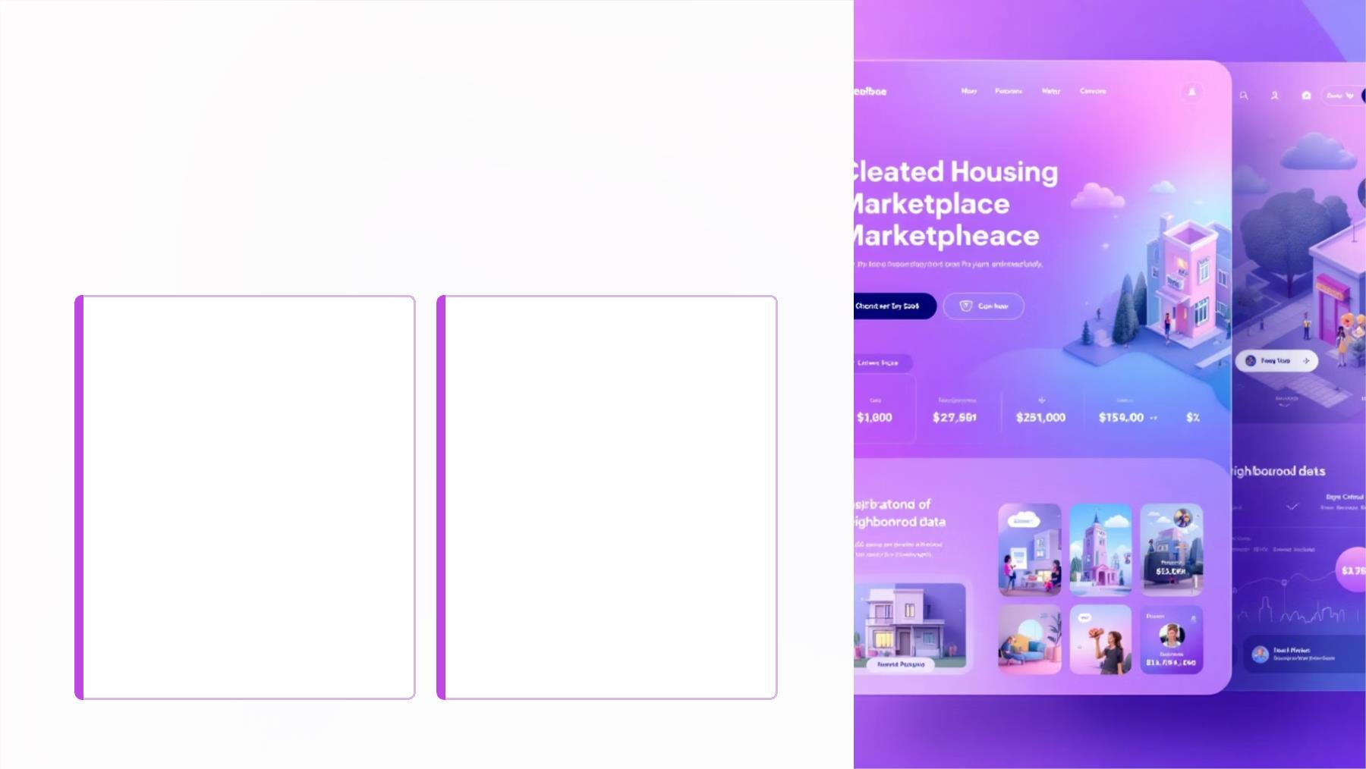
The Challenge We
Conquered: Our Problem
Statement
The Pain Point
"Inefficient Communication
"Disorganized processes
"Manual Visitor Management
"Delayed updates
Many residential societies face
significant challenges in day-to-
day management due to
manual, unorganized processes.
These issues often lead to:
"Hard-to-track complaints
"Inconvenient amenity
reservations
"Lack of centralized data

Slide 5

Project Overview &
Objectives
Project Vision
Our Society Coordination System is a web-based
platform designed to modernize and streamline
residential society operations.
Key Objectives
It tackles common challenges like
inefficient communication,
manual processes,
and security gaps,
providing residents and management with
seamless tools for:
Communication & Announcements
Complaint & Visitor Management
Amenity Booking & Billing
Core Functionality
Web Based Platform
Interactive dashboards
Admin control
Automated data injestion

Slide 6
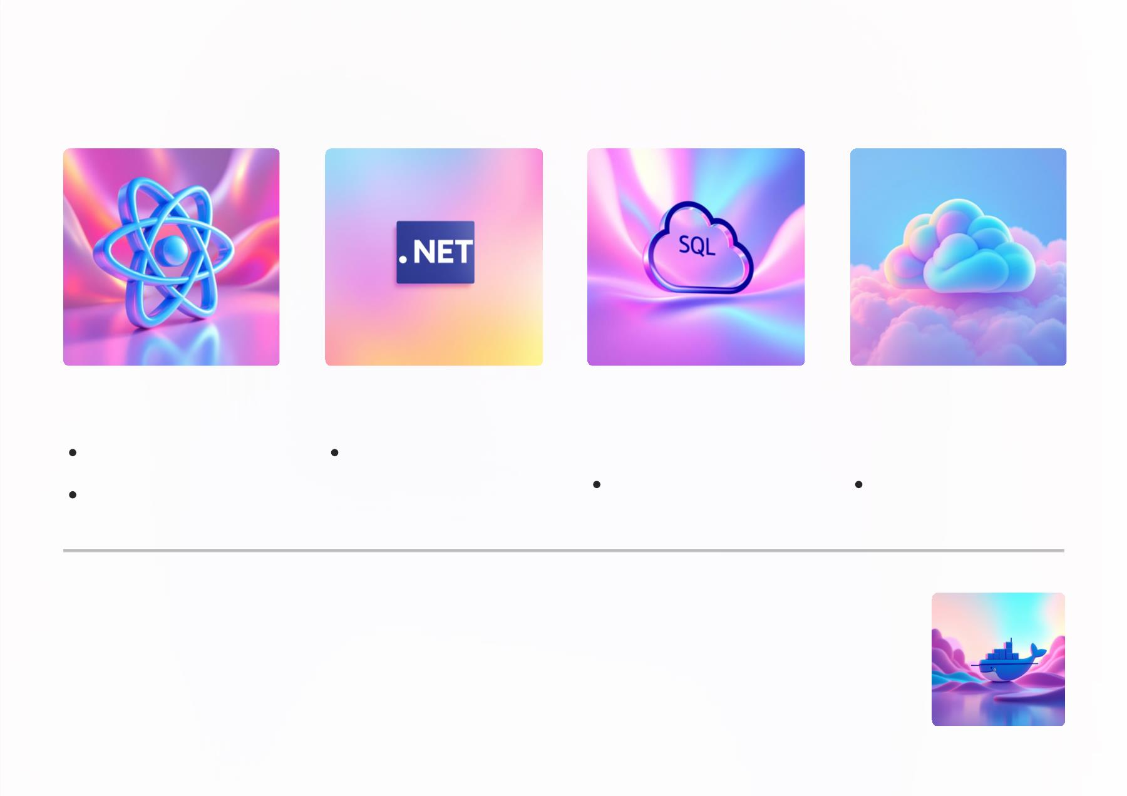
Technical Specifications
Frontend
Backend
Database
Management
Cloud
Infrastructure
React.js
. Net Framework
Tailwind CSS
MS SQL
Microsoft Azure
Key Technologies: Docker for containerization

Slide 7

Our Major Outcomes
Interactive Dashboard
Secure Role-Based Access Control
Role-based dashboard for Admins and Residents.
Successfully implemented user login with token-
based authentication.
Visual summaries of complaints, bookings, bills,
and users.
Multiple user roles supported: Admin, Resident,
Security Staff, Super Admin.
Targeted Announcements
Online Complaint Handling
Admins can publish announcements.
Residents can raise complaints.
Global or targeted delivery to specific wings or
flats.
Status tracking: Pending, In Progress, Resolved,
Rejected.
Visitor Entry Logging
Amenity Booking System
Security staff can log guest or delivery entries.
Real-time exit tracking and visitor categorization.
Residents can book amenities like clubhouse,
gym, etc.
Time-slot selection and payment tracking
included.
Digital Maintenance Billing
Responsive Frontend with React
Auto-generated bills based on area (Rate per Sq.
Ft).
Built using modern UI components and Tailwind
CSS.
Tracks due dates, payments, and transactions.
Seamlessly integrates with a .NET backend.

Slide 8
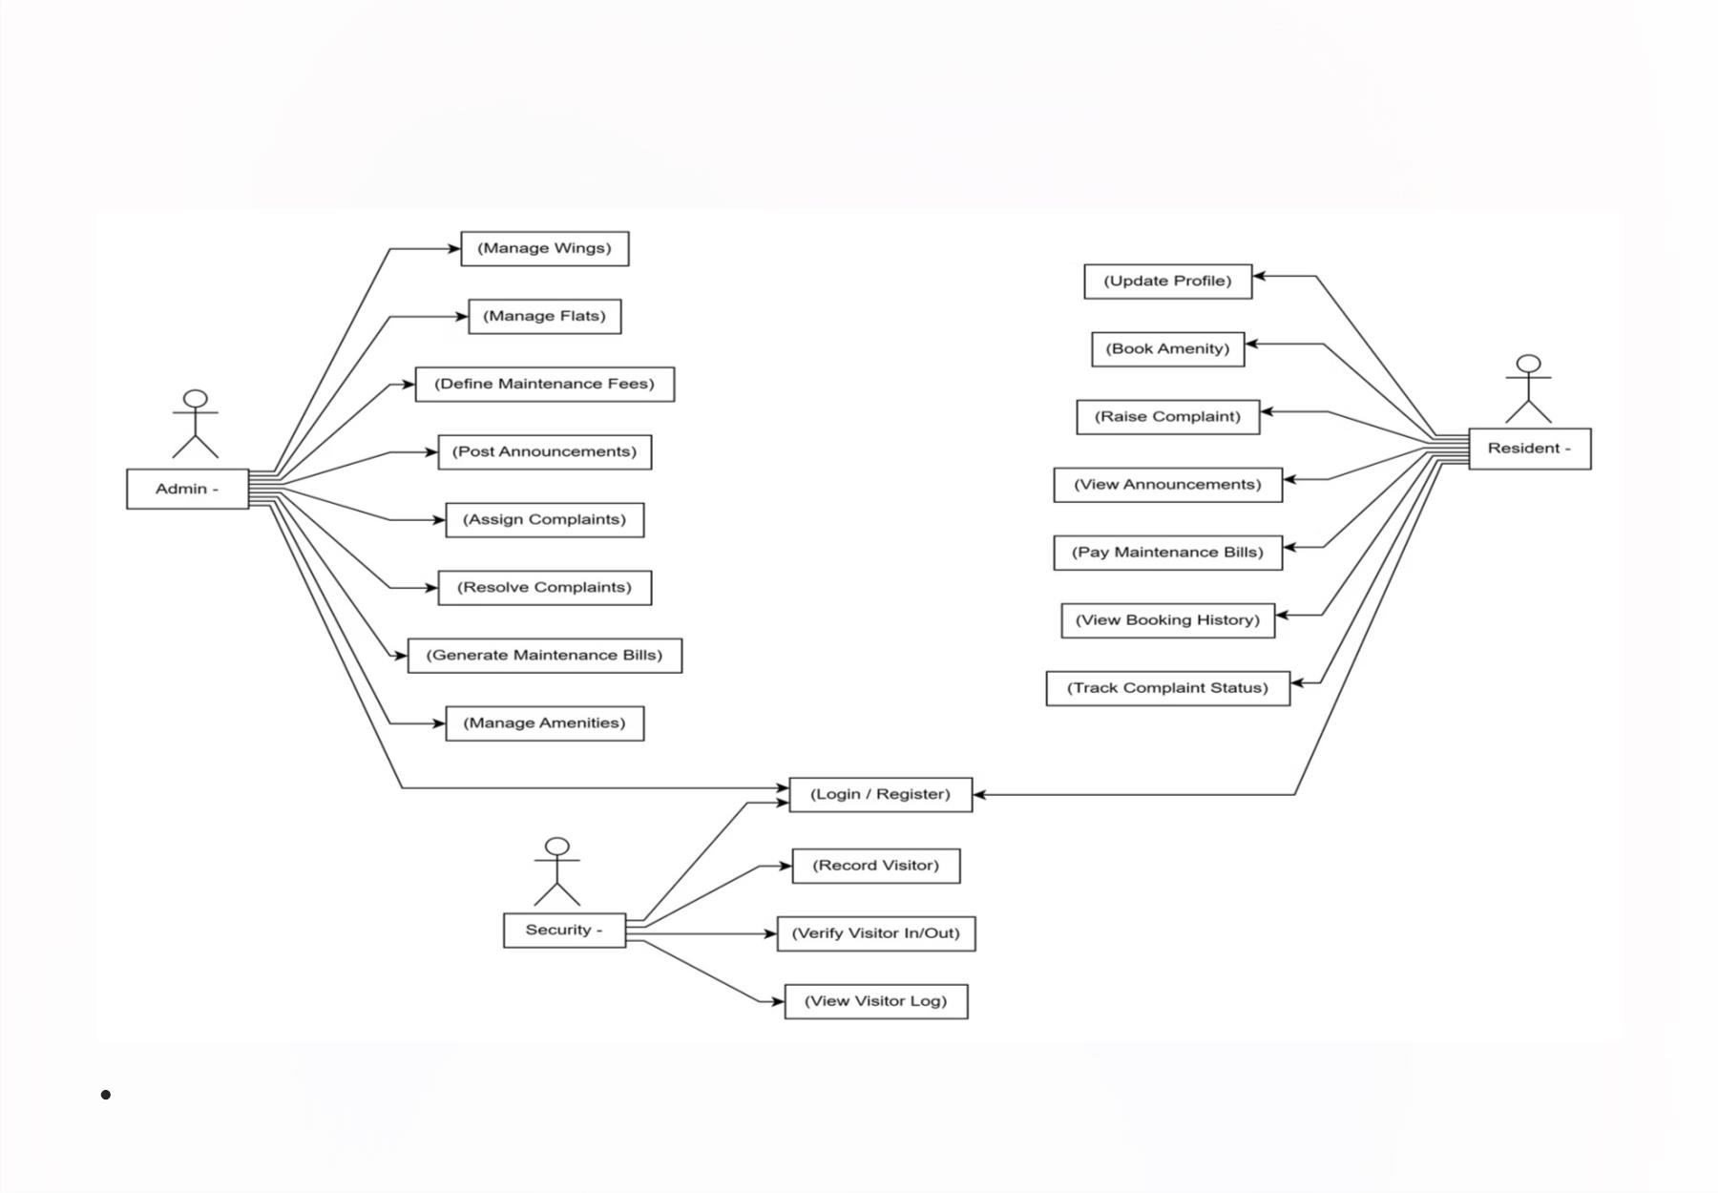
Usecase Diagram
Use Case Diagram: Visualizes user goals and system responses, defining how 'Admins' manage users and 'Users' submit data.

Slide 9
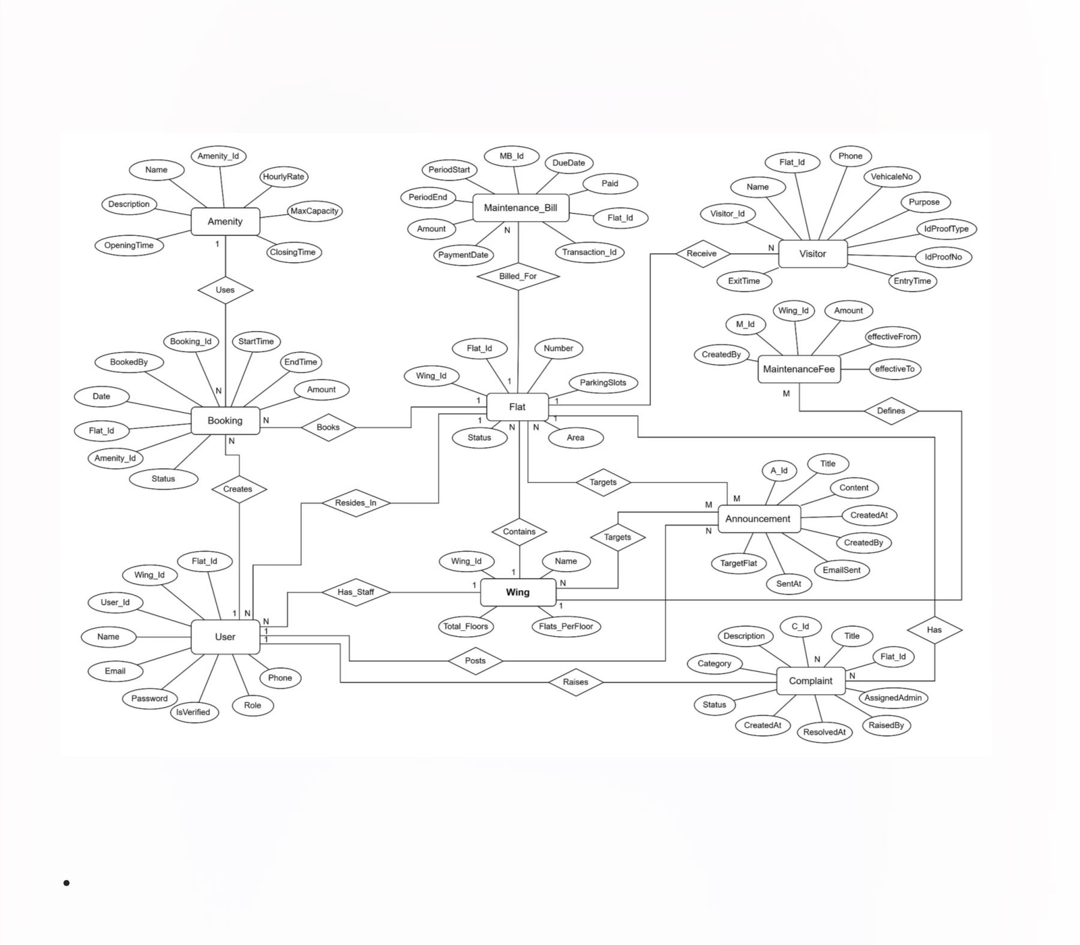
ER-Diagram
ER Diagram: Unveils the database structure and relationships between 'Users,' 'Projects,' and 'Data Points' entities.

Slide 10
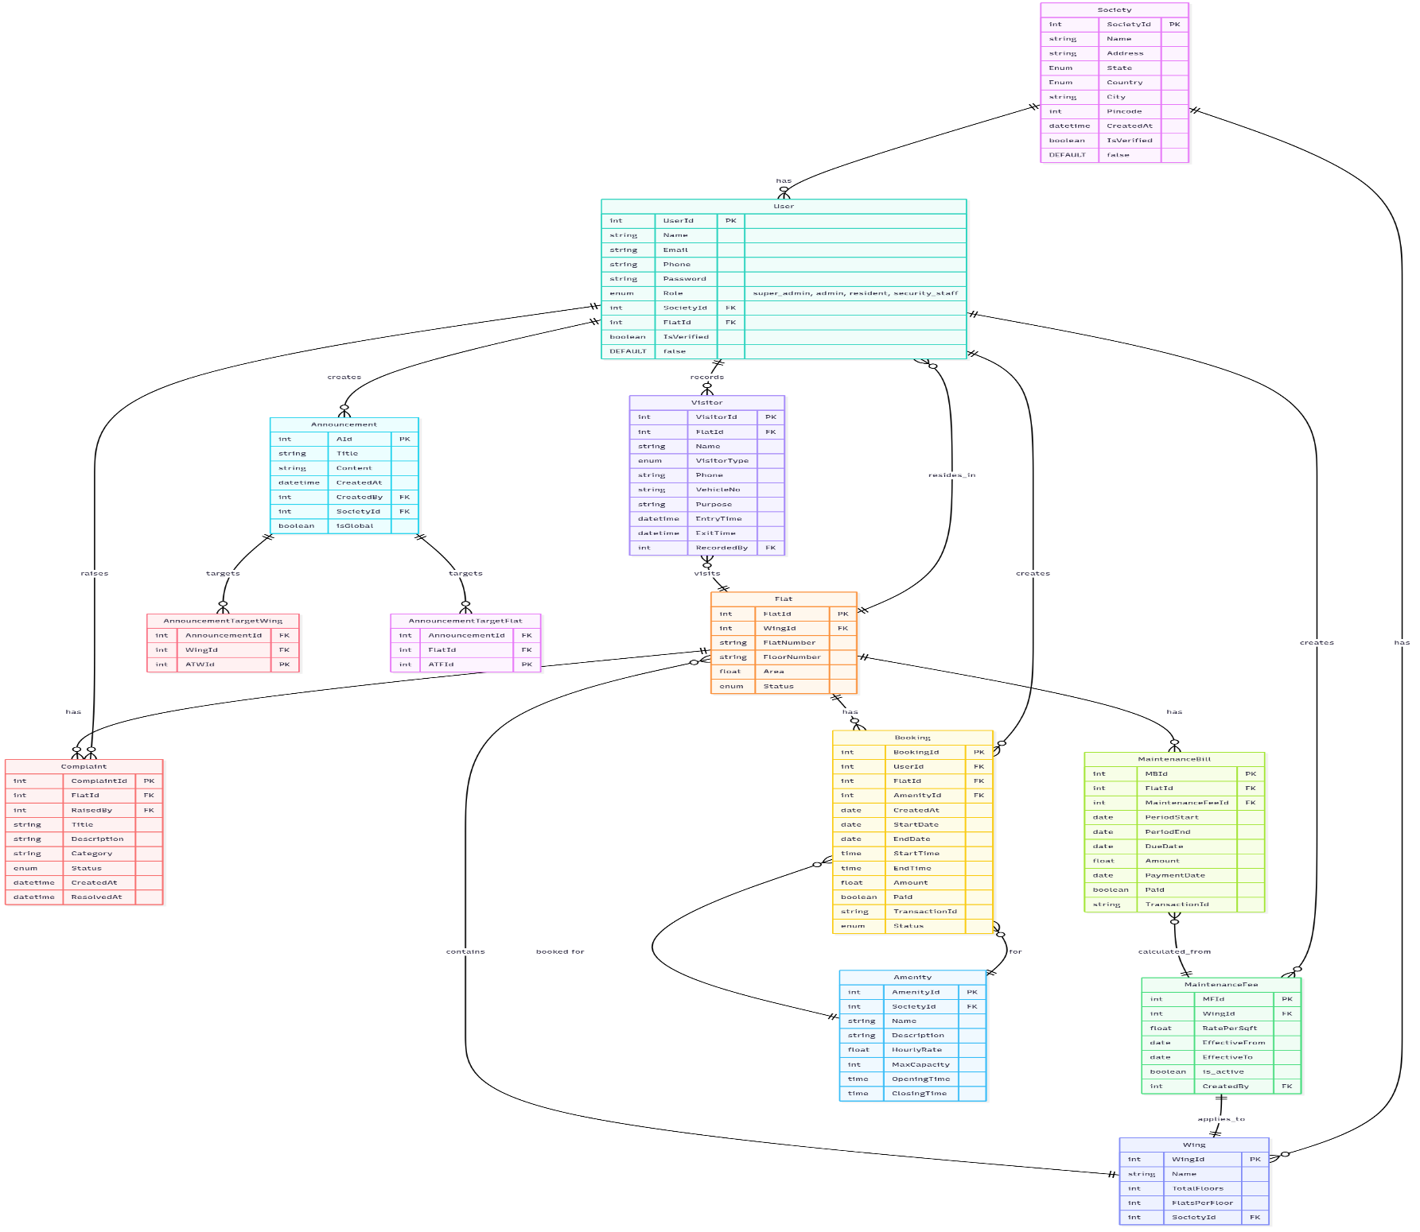
Class Diagram
Class Diagram: Represents the system's static structure, defining 'User,' 'DataProcessor,' and 'ReportGenerator' classes and their
interactions.

Slide 11
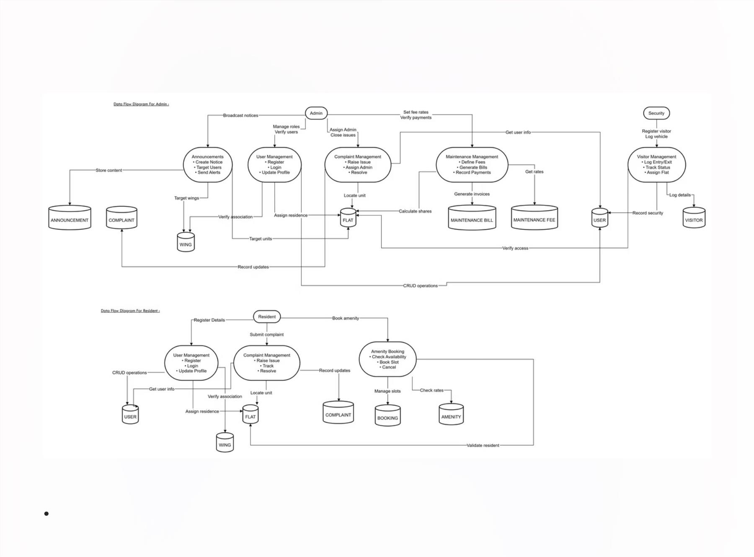
Data Flow Diagram
Data Flow Diagram: Traces the movement and transformation of data from raw input to analyzed insights and dashboard visualizations.

Slide 12
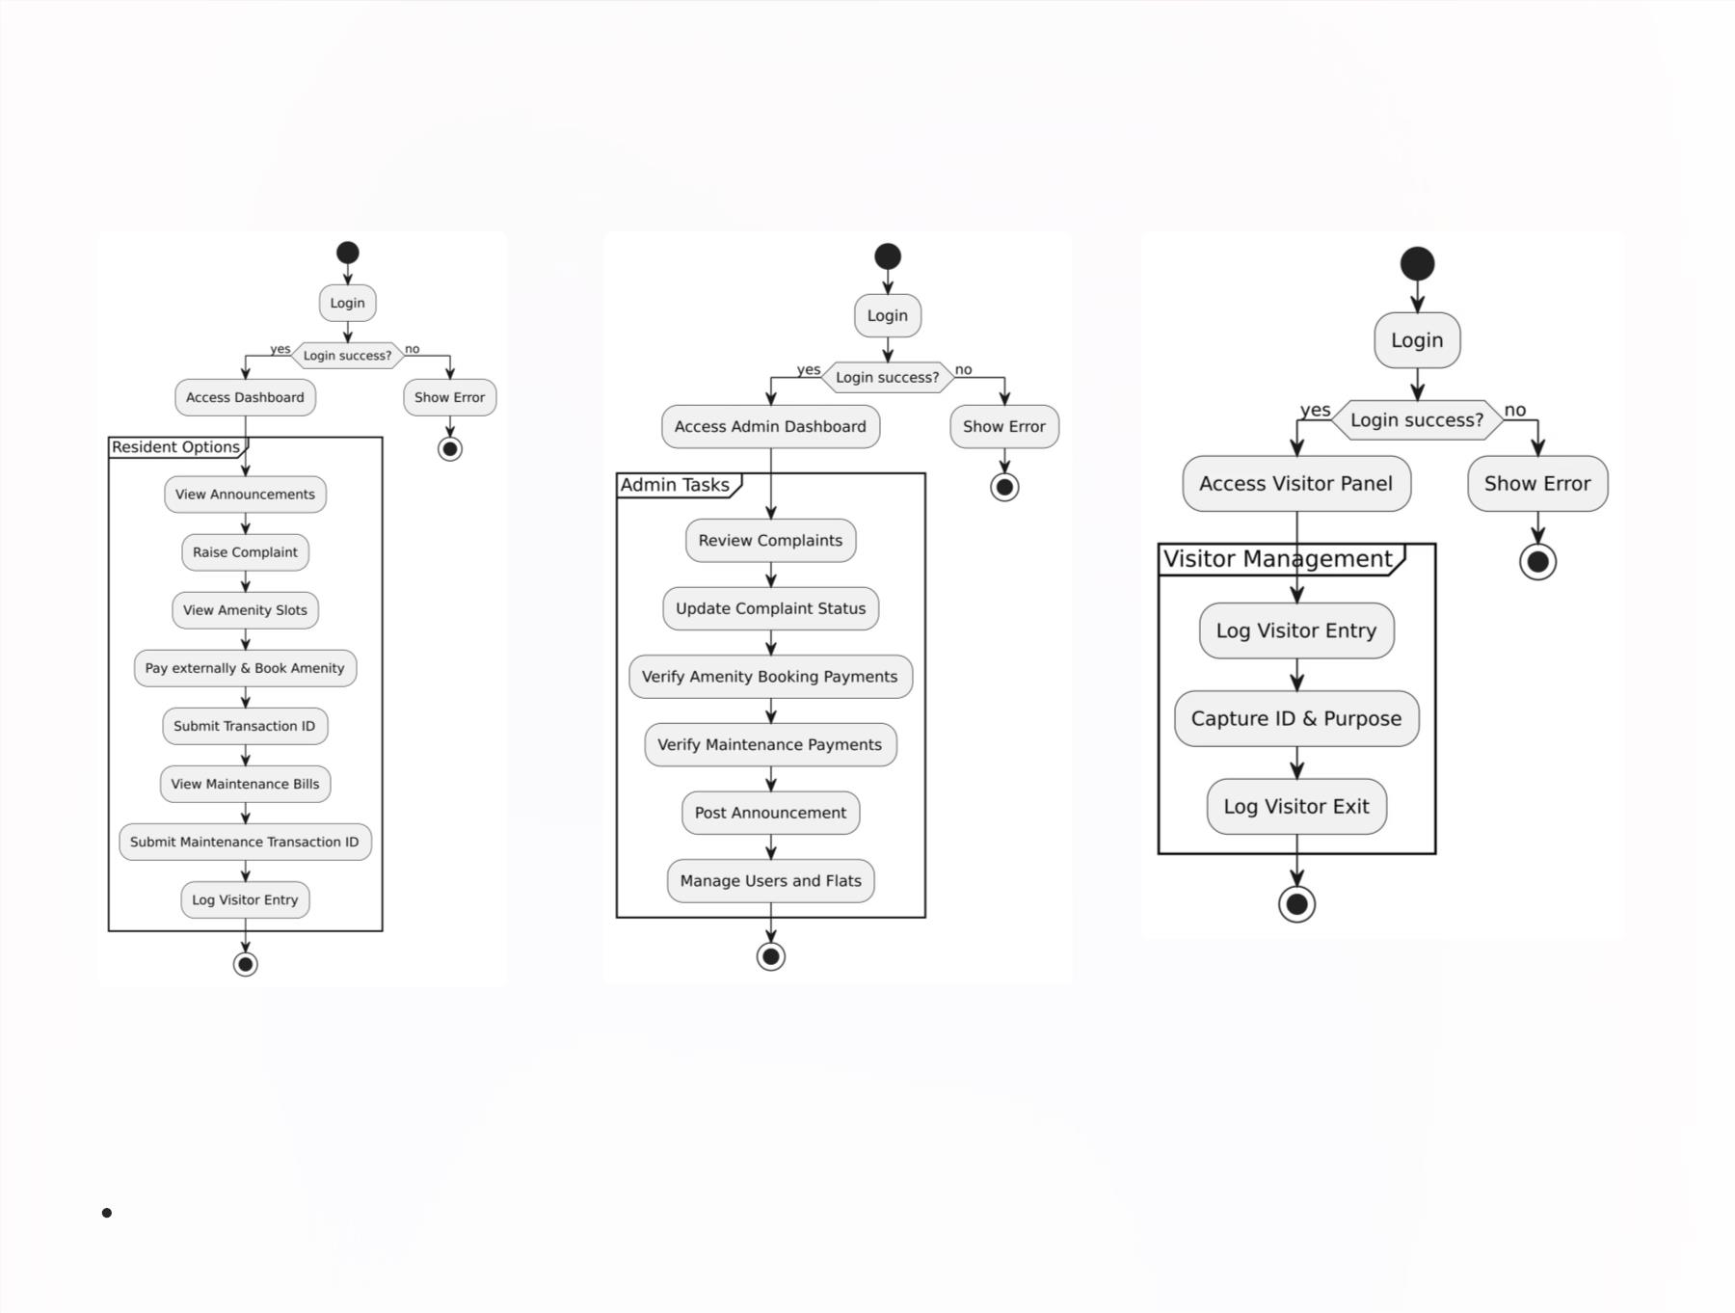
Activity Diagram
Activity Diagram: Maps the step-by-step workflow for the automated data ingestion and validation pipeline.

Slide 13
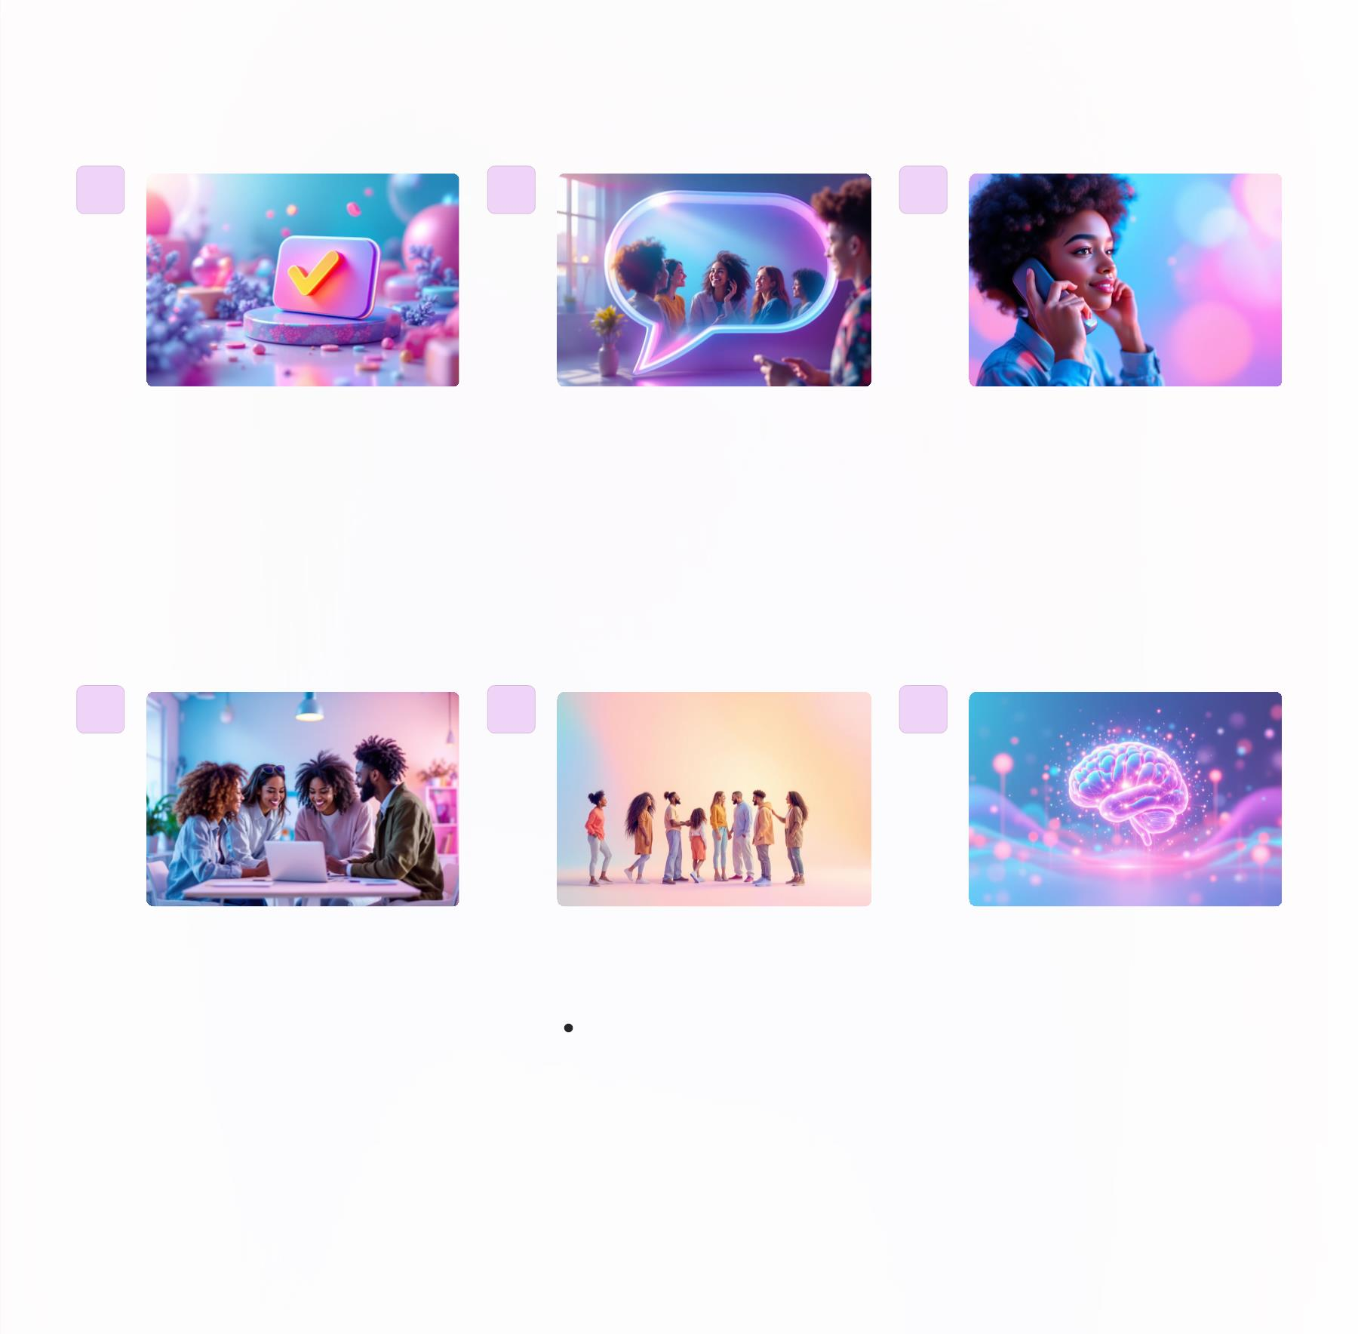
Future Scope
Direct online
payment
functionality for
maintenance bills
and amenity
bookings.
A platform for
Centralized storage of
emergency contacts
for each flat.
residents to discuss
common issues, share
ideas, and organize
events.
Vendor Management:
A module to manage
service providers
(plumbers,
electricians, cleaners)
and their schedules.
Multi-Society Apartment
Integration
Advanced Data
Analytics and
Reporting
Allow a super admin to
manage multiple
societies under one
platform.
Implement robust analytics
to provide insights into
society operations, usage
patterns, and financial
health.

Slide 14

Conclusion
The Society Coordination System is a simple yet powerful
platform designed to streamline and modernize everyday
activities in residential societies. It helps improve efficiency,
enhance the resident experience, and strengthen security. By
replacing outdated methods with smart, digital tools, the
system creates a more organized, transparent, and better living
experience for everyone. By leveraging a robust and user-
friendly platform, we aim to:
1 Improve Efficiency
2 Enhance Resident Experience
3 Boost Security
4 Foster Community

Slide 15

Thank You
We appreciate your time and engagement today. The Housing
Hub system is designed to transform residential communities
into more connected, efficient, and harmonious living spaces.

